Slide 1
Assembly Language Intro
Notes prepared for comp7615
Select slides adapted from “Assembly Language for x86 Processors”, 7th Edition, Kip Irvine, and comp1113 Applied Mathematics notes
Carly Orr, BCIT

Slide 2
Session Overview
Data Representation
Boolean Operations

Slide 3
Data Representation
Binary Numbers
Translating between binary and decimal
Binary Addition
Integer Storage Sizes
Hexadecimal Integers
Translating between decimal and hexadecimal
Hexadecimal subtraction
Signed Integers
Binary subtraction
Character Storage

Slide 4
Binary Numbers
Digits are 1 and 0
1 = true
0 = false
MSB – most significant bit
LSB – least significant bit
Bit numbering:

Slide 5
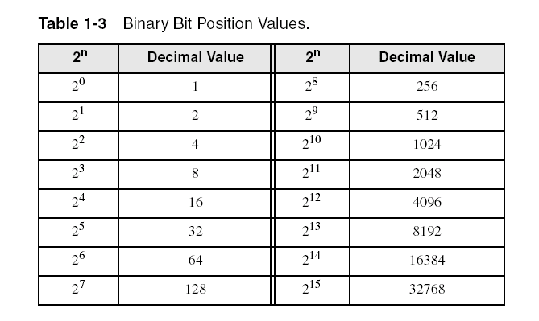
Binary Numbers
Each digit (bit) is either 1 or 0
Each bit represents a power of 2:
Every binary number is a sum of powers of 2

Slide 6
Translating Binary to Decimal
Weighted positional notation shows how to calculate the decimal value of each binary bit:
dec = (D_{n-1} × 2^{n-1}) + (D_{n-2} × 2^{n-2}) + ... + (D₁ × 2¹) + (D₀ × 2⁰)
D = binary digit
binary 00001001 = decimal 9:
(1 × 2³) + (1 × 2⁰) = 9

Slide 7
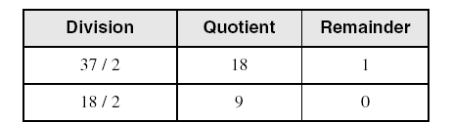
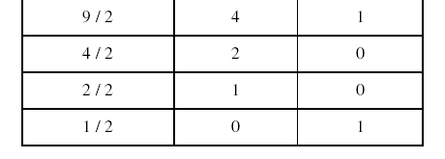
Translating Unsigned Decimal to Binary
Repeatedly divide the decimal integer by 2. Each remainder is a binary digit in the translated value:
37 = 100101

Slide 8
Binary Addition
Starting with the LSB, add each pair of digits, include the carry if present.

Slide 9
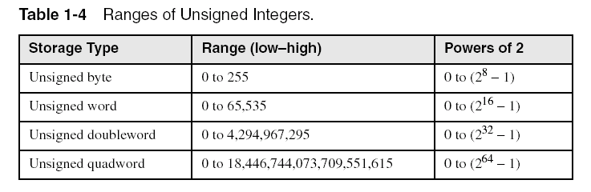
Integer Storage Sizes
Standard sizes:
Checkpoint: What is the largest unsigned integer that may be stored in 20 bits?

Slide 10
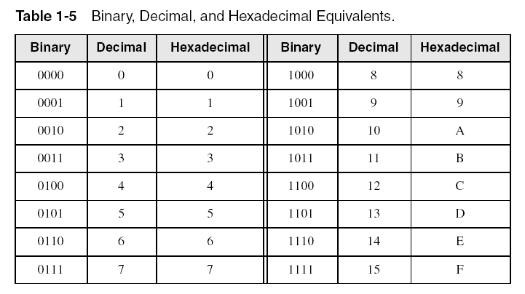
Hexadecimal Integers
Binary values are represented in hexadecimal.

Slide 11

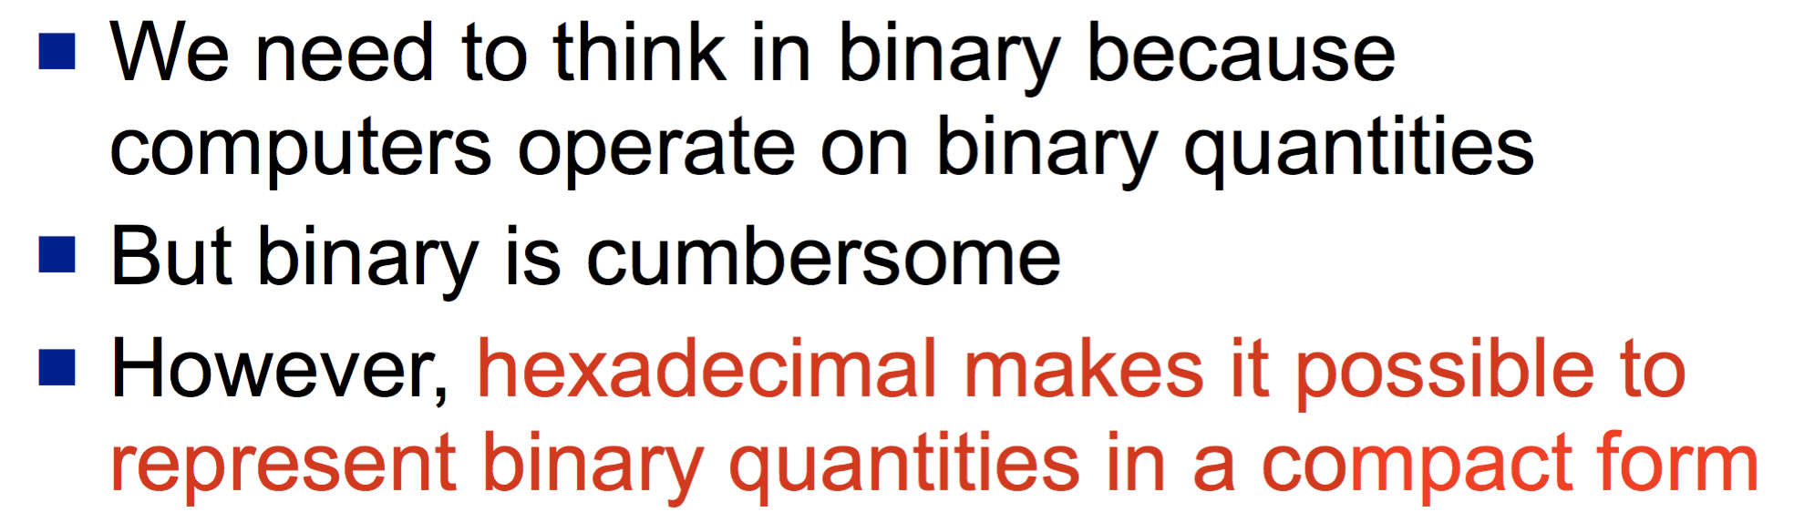
Translating Binary to Hexadecimal
Each hexadecimal digit corresponds to 4 binary bits.
Example: Translate the binary integer 000101101010011110010100 to hexadecimal:

Slide 12
Converting Hexadecimal to Decimal
Multiply each digit by its corresponding power of 16:
dec = (D₃ × 16³) + (D₂ × 16²) + (D₁ × 16¹) + (D₀ × 16⁰)
Hex 1234 equals (1 × 16³) + (2 × 16²) + (3 × 16¹) + (4 × 16⁰), or decimal 4,660.
Hex 3BA4 equals (3 × 16³) + (11 * 16²) + (10 × 16¹) + (4 × 16⁰), or decimal 15,268.

Slide 13
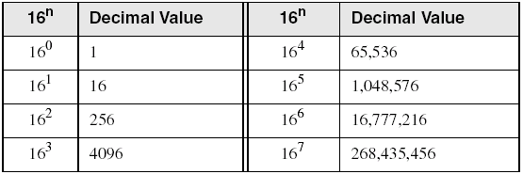
Powers of 16
Used when calculating hexadecimal values up to 8 digits long:

Slide 14
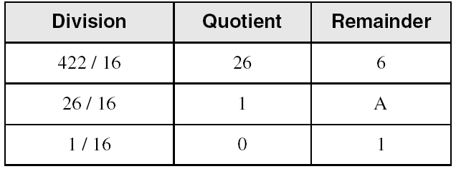
Converting Decimal to Hexadecimal
decimal 422 = 1A6 hexadecimal

Slide 15
Hexadecimal Addition
Divide the sum of two digits by the number base (16). The quotient becomes the carry value, and the remainder is the sum digit.
1
1
36 28 28 6A
42 45 58 4B
78 6D 80 B5
21 / 16 = 1, rem 5
Important skill: Programmers frequently add and subtract the addresses of variables and instructions.

Slide 16
Hexadecimal Subtraction
When a borrow is required from the digit to the left, add 16 (decimal) to the current digit's value:
16 + 5 = 21
−1
C6 75
A2 47
24 2E
Practice: The address of var1 is 00400020. The address of the next variable after var1 is 0040006A. How many bytes are used by var1?

Slide 17
Signed Integers
The highest bit indicates the sign. 1 = negative, 0 = positive
If the highest digit of a hexadecimal integer is > 7, the value is negative. Examples: 8A, C5, A2, 9D

Slide 18
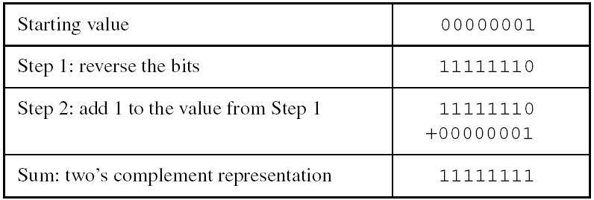
Forming the Two's Complement
Negative numbers are stored in two's complement notation nowadays in all computers
Represents the additive Inverse
Steps:
Note that 00000001 + 11111111 = 00000000

Slide 19
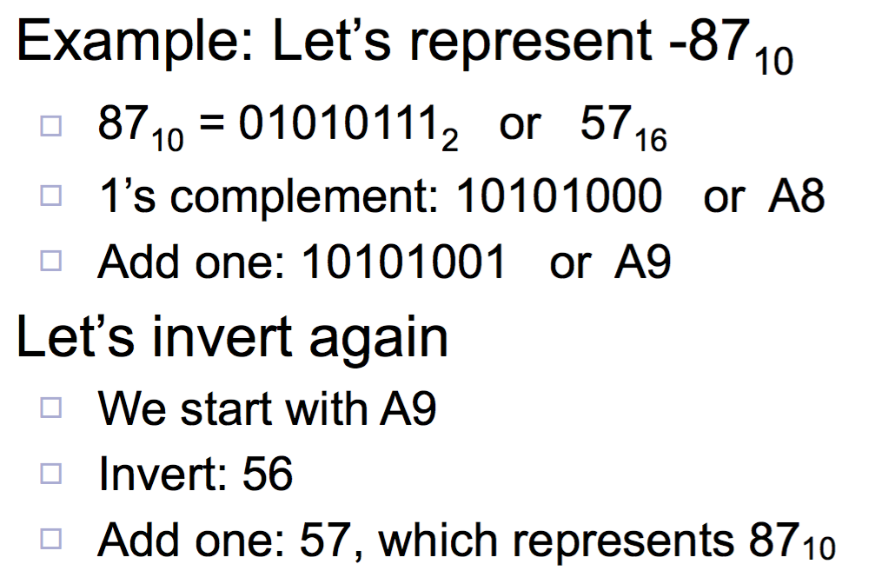
Two’s complement of a negative number gives…?

Slide 20
Two’s complement Notes
A carry may be generated but it is ignored!
When adding two X-bit quantities, the result is also X-bits
2’s complement makes for simple arithmetic logic gates when building ALUs
The leftmost bit still indicates the sign of the number (0 is positive, 1 is negative)
What happens when you take the 2’s complement of 0000 0000?
Thus, signed bytes have values from -128 to +127 (a total of 256 representations, including 0)

Slide 21
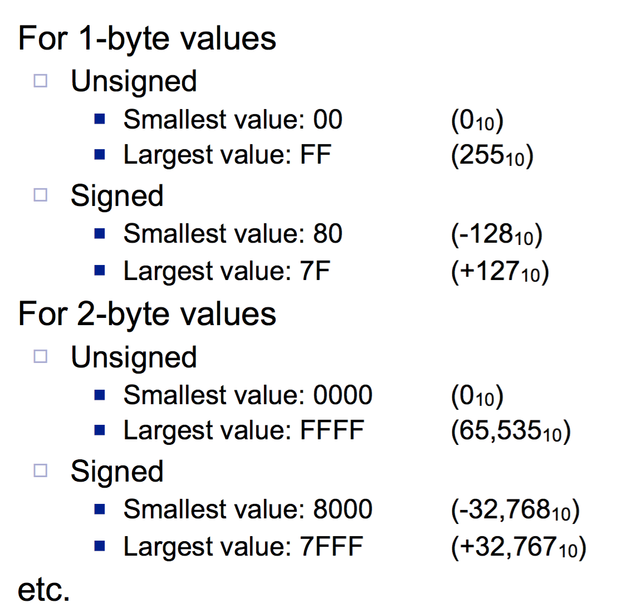
Range of numbers
For 1-byte
Smallest, largest (unsigned)?
Smallest, largest (signed)?
For 2-byte
Smallest, largest (unsigned)?
Smallest, largest (signed)?

Slide 22
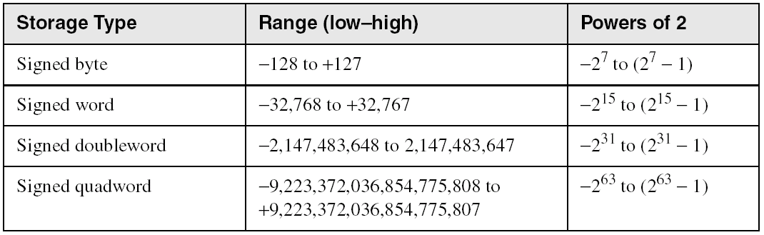
Ranges of Signed Integers
The highest bit is reserved for the sign. This limits the range:
Practice: What is the largest positive value that may be stored in 20 bits?

Slide 23
Binary Subtraction
When subtracting A – B, convert B to its two's complement
Add A to (–B)
0 0 0 0 1 1 0 0 0 0 0 0 1 1 0 0
– 0 0 0 0 0 0 1 1 1 1 1 1 1 1 0 1
0 0 0 0 1 0 0 1
Practice: Subtract 0101 from 1001.

Slide 24
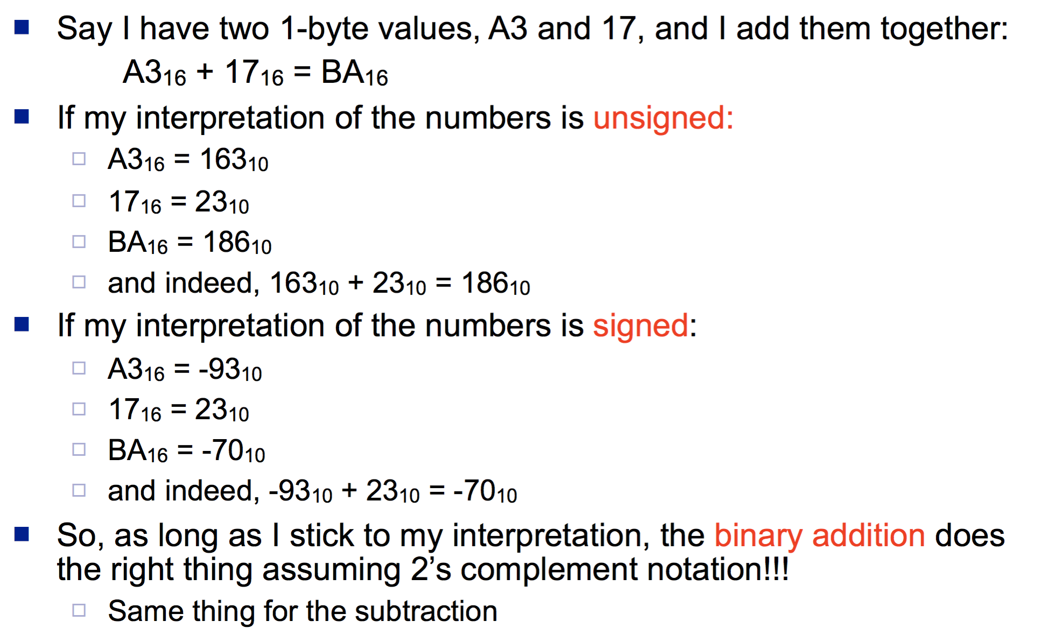
Something “Magical” about 2’s complement

Slide 25
Know How To Do the Following:
Form the two's complement of a hexadecimal integer
Convert signed binary to decimal
Convert signed decimal to binary
Convert signed decimal to hexadecimal
Convert signed hexadecimal to decimal

Slide 26
Connection to Assembly
The computer has no idea what the data means
In HLL, we have data types
In AL, there are no data types
Some instructions operate on all “data types”
You (the assembly programmer) must use the right instruction for the right reasons

Slide 27
Character Storage
Character sets
Standard ASCII (0 – 127)
Extended ASCII (0 – 255)
ANSI (0 – 255)
Unicode (0 – 65,535)
Null-terminated String
Array of characters followed by a null byte
Using the ASCII table
back inside cover of book

Slide 28
Numeric Data Representation
pure binary
can be calculated directly
ASCII binary
string of digits: "01010101"
ASCII decimal
string of digits: "65"
ASCII hexadecimal
string of digits: "9C"
next: Boolean Operations

Slide 29
Session Overview
Welcome to Assembly Language
Virtual Machine Concept
Data Representation
Boolean Operations

Slide 30
Boolean Operations
NOT
AND
OR
Operator Precedence
Truth Tables

Slide 31
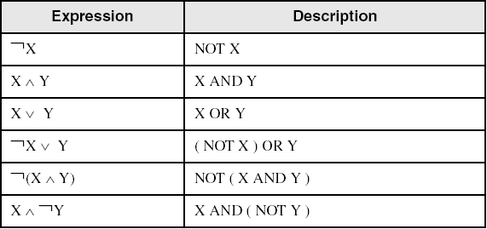
Boolean Algebra
Based on symbolic logic, designed by George Boole
Boolean expressions created from:
NOT, AND, OR

Slide 32
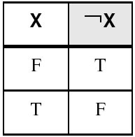
NOT
Inverts (reverses) a boolean value
Truth table for Boolean NOT operator:
Digital gate diagram for NOT:

Slide 33
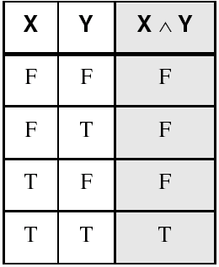
AND
Truth table for Boolean AND operator:
Digital gate diagram for AND:

Slide 34
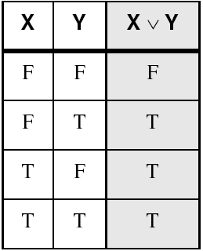
OR
Truth table for Boolean OR operator:
Digital gate diagram for OR:

Slide 35
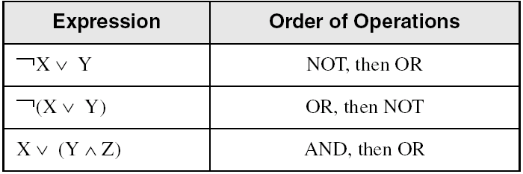
Operator Precedence
Examples showing the order of operations:

Slide 36
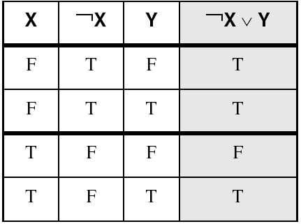
Truth Tables (1 of 3)
A Boolean function has one or more Boolean inputs, and returns a single Boolean output.
A truth table shows all the inputs and outputs of a Boolean function
Example: ¬X ∨ Y

Slide 37
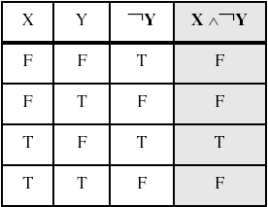
Truth Tables (2 of 3)
Example: X ∧ ¬Y

Slide 38
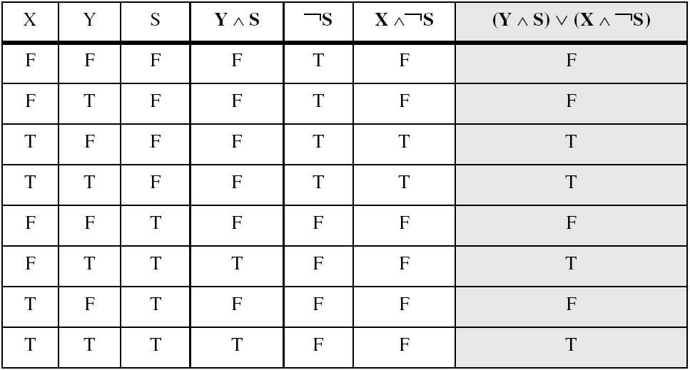
Truth Tables (3 of 3)
Example: (Y ∧ S) ∨ (X ∧ ¬S)
Two-input multiplexer

Slide 39
Summary
Assembly language helps you learn how software is constructed at the lowest levels
Assembly language has a one-to-one relationship with machine language
Each layer in a computer's architecture is an abstraction of a machine
layers can be hardware or software
Boolean expressions are essential to the design of computer hardware and software

Slide 40
54 68 65 20 45 6E 64
What do these numbers represent?

